Slide 1
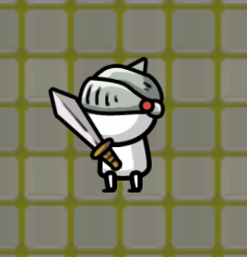
Project Game UnKonwn
Who: Haoran An

Slide 2

Overview
Introduction
Background
Requirement
Game Object
Design Documents
Implementation
Testing
Demo
Q&A

Slide 3
Introduction
2D roguelike game made by Unity
Roguelike
Start with nothing
Random map
Random enemy
Random skill

Slide 4

Background
Game Player
Not good to write a story
Often play roguelike games with my friends

Slide 5

Quick Review
MVP
A Test Map includes Map, Player, and Enemy
V 1.0
Minimum two different weapons and eight skills
Minimum 1 chapter and a boss
Basic UI

Slide 6
Game Object
The Program will create a random map and random enemy-created points
The player should kill enough enemies to close the points
After the player closes all points, the transport point will enable the hit box and let the player could transport to the boss room
Fight the boss and end the game

Slide 7
Design Documents
Player
Skill
Enemy
Item

Slide 8
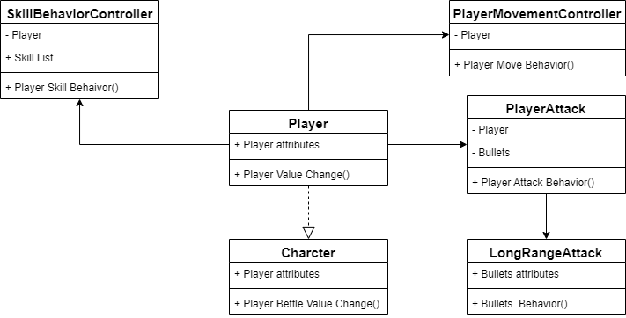
Player

Slide 9
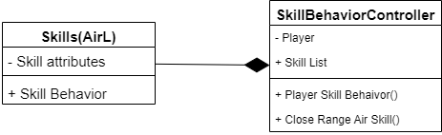
Skill

Slide 10
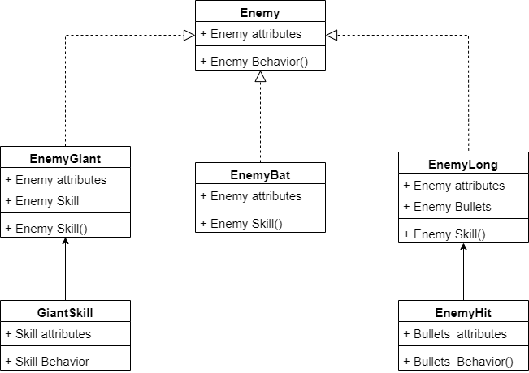
Enemy

Slide 11
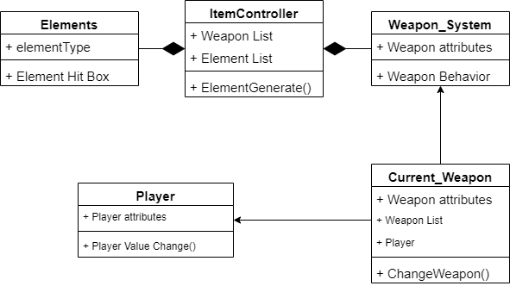
Item

Slide 12
Implementation
Tools
Code Structure
Design Ideas

Slide 13
Implementation - Tools
Unity
Visual Studio – IDE
C# - Language
Unity Asset Store
https://assetstore.unity.com/

Slide 14

Implementation Code Structure
Awake()
gameObject was created
Start()
Before first Update()
Update()
Update every frame
OnTriggerEnter2D(Collider2D collision)
Instantiate(gameObject, transform.position, transform.rotation);

Slide 15
Design
Player
Player Attack
Skill
Enemy Move

Slide 16
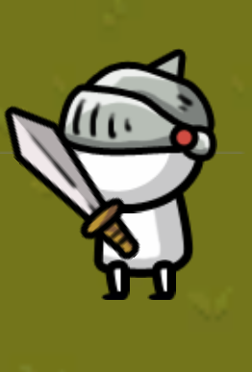
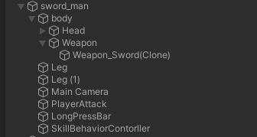
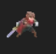
Player

Slide 17
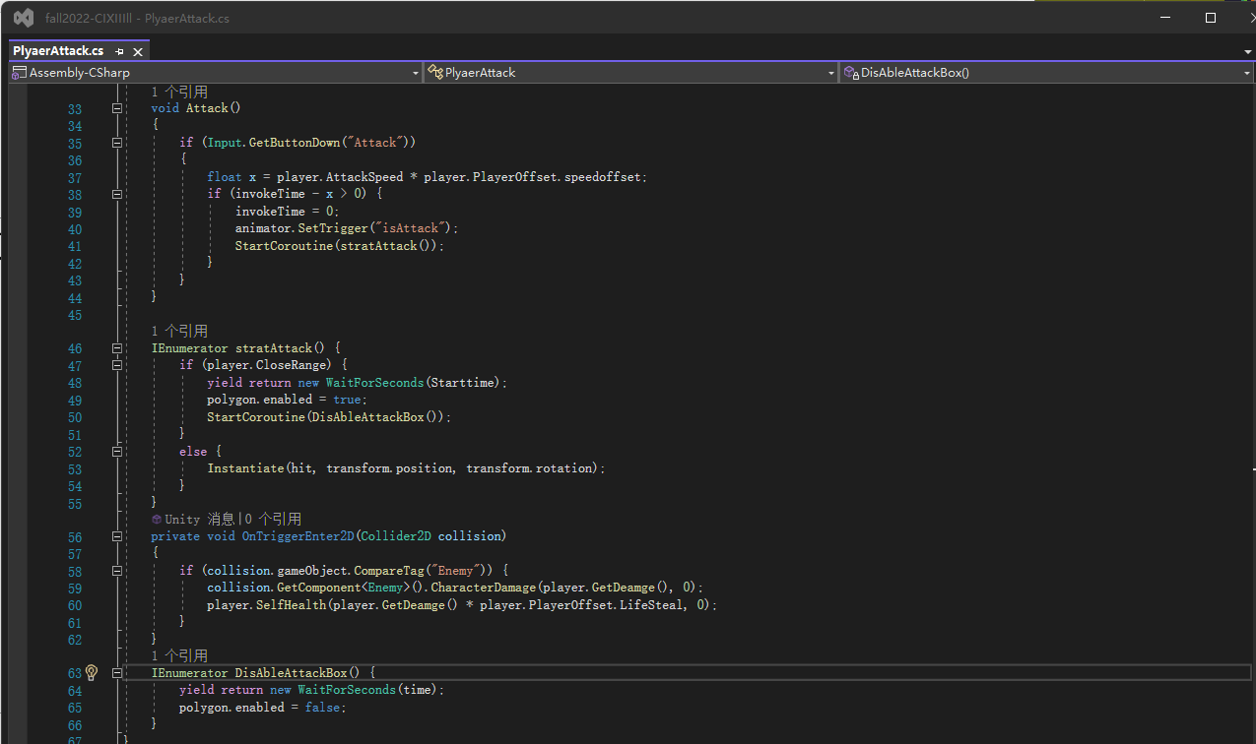
Attack

Slide 18
Skills
Element and Attack Type
Fire
Erath
Air
Water

Slide 19
Close Range Skill
Fire
Continuous skill
Earth
Long Press
Air
Player Movement
Water
Enemy Control

Slide 20
Long Range Skill
Fire
Second Behavior
Earth
Create Wall
Air
Move Around
Water
Continuous Hp Loss

Slide 21
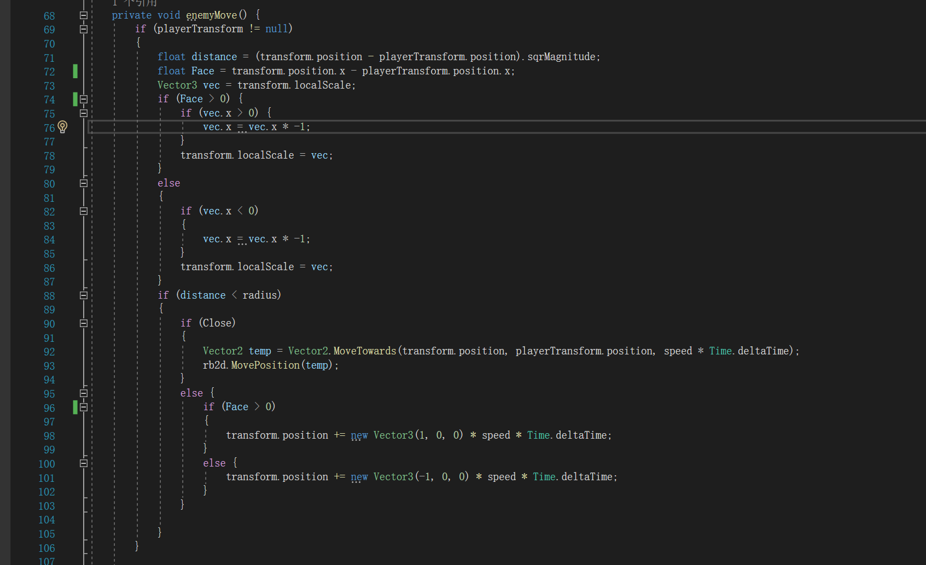
Enemy

Slide 22
Testing
Testing consisted of
Visual Studio debugger
Debug.Log();
Test Map
Stackoverflow
Bilibili.com

Slide 23
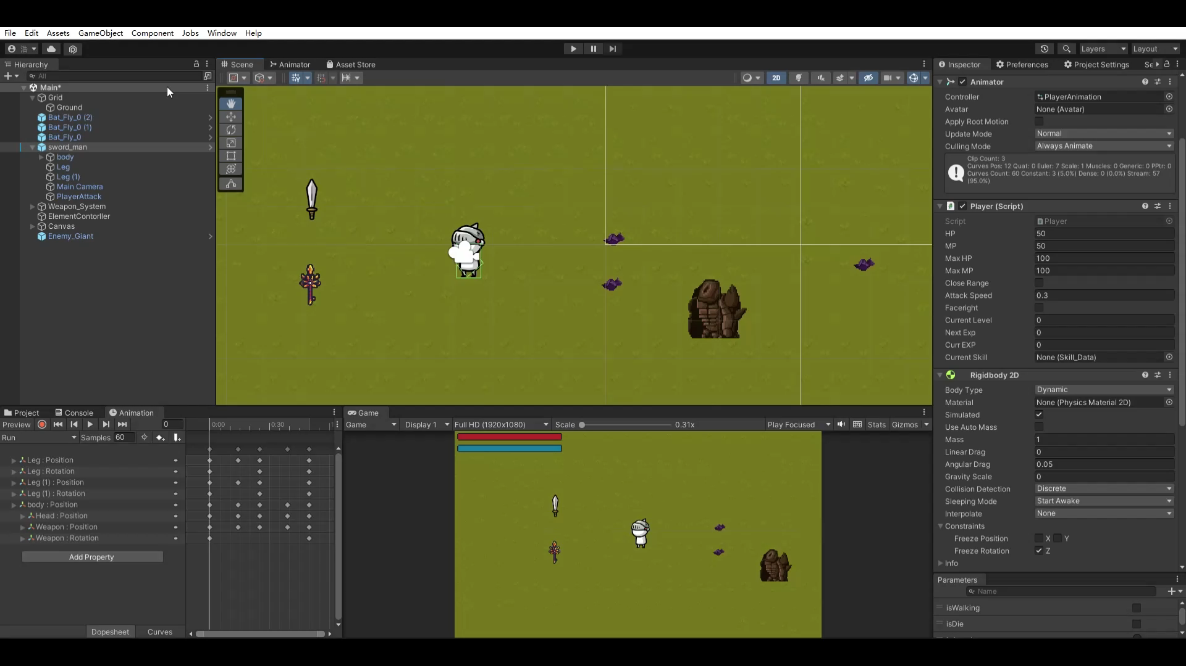
Attack

Slide 24
Future Work
More Enemy
Sound
Skill tree

Slide 25
Demo- TestMap

Slide 26
Demo - Game

Slide 27

Q&A

